Slide 1



Slide 2

BUSINESS ANALYTICS Introduction to Business Analytics and Core Business Functions
BUSINESS ANALYSIS Introduction to Business Analysis and Core Business Functions

Slide 3
BUSINESS ANALYSIS COURSE OBJECTIVES
By the end of the course, students will be able to:
Understand the role and scope of business analysis in organizations
Analyze business models, structures, and functional areas
Identify and manage stakeholders effectively
Elicit, document, and validate business requirements
Model and improve business processes using standard techniques
Use data and KPIs to support decision-making
Communicate insights through reports and visualizations
Apply business analysis practices in Agile environments
Demonstrate ethical and professional conduct
Deliver a real-world business analysis project.

Slide 4
BUSINESS ANALYTICS COURSE SCOPE
WEEK 1 | Introduction to Business Analysis, BA vs DA vs BI
WEEK 2 | Business Functions, Business Models, Terminology
WEEK 3 | Stakeholders, Communication & Conflict Management
WEEK 4 | Requirements Types & Quality
WEEK 5 | Elicitation Techniques
WEEK 6 | Documentation (BRD, SRS, User Stories)
WEEK 7 | Process Modeling (AS-IS/TO-BE, BPMN)
WEEK 8 | Process Improvement & Root Cause Analysis
WEEK 9 | Types of Analytics
WEEK 10 | KPIs & Business Metrics

Slide 5
BUSINESS ANALYTICS COURSE SCOPE
WEEK 11 | Visualization Tools
WEEK 12 | Reporting & Data Storytelling
WEEK 13 | BA in Agile
WEEK 14 | Ethics & Professional Conduct

Slide 6
TEACHING METHODOLOGY
Lectures on business analysis (industry oriented)
Real-world problem solving
Student participation through presentations
Learning methods
Skill-focused
Analytical focused
Groups and teams
Project-based

Slide 7
EVALUATION METHOD
Quizzes – 5%
Short Assignments – 5%
Midterm Examination I – 15%
Midterm Examination II – 15%
Business-related Assignment & Report – 10%
Presentation – 10%
Final Examination – 40%

Slide 8
SEMESTER PROJECT OVERVIEW
Real business scenario
Problem identification
Analysis
Proposed solution
Presentation & report

Slide 9
Why This Course Matters
Organizations fail due to poor understanding of needs
Business Analysts reduce this gap
High-demand role globally
Bridge between business and technology

Slide 10
Learning Objectives – WEEK 1
Understand course structure
Define Business Analysis
Understand BA responsibilities
Differentiate BA, DA, BI, Business Analytics

Slide 11
WHAT IS BUSINESS ANALYSIS? Business Analysis is the practice of understanding business problems, identifying business needs, and recommending solutions that create value for stakeholders.
In simple words:
👉 Business Analysis = Understanding Problems + Understanding People + Defining Needs + Recommending Solutions
A Business Analyst:
Identifies what problem the business is facing
Understands why the problem exists
Works with stakeholders to define what is needed
Helps design solutions that solve the problem

Slide 12
✅ What Business Analysis IS
Business Analysis IS about:
Understanding business problems
Understanding business processes
Gathering requirements
Talking to stakeholders
Documenting needs
Improving workflows
Supporting solution design
Think of BA as:
🧠 Thinker 🗣 Communicator 🧩 Problem Solver 📋 Planner
❌ What Business Analysis is NOT
Business Analysis is NOT:
Coding
Programming
Database administration
Server management
Network engineering
Graphic designing
Only documentation
🔹 Important Clarification
A BA may understand technology, but:
👉 BA does NOT build systems 👉 BA helps decide what should be built

Slide 13
PRACTICAL EXAMPLE
🔹 Example
Bank customers complain that mobile app is slow.
BA will:
Talk to customers
Talk to business managers
Analyze complaints
Identify root cause
Recommend improvement
BA does NOT directly code the app.
Explanation:
A Business Analyst is a problem solver for the business. They do NOT jump into building software. They first understand the business problem and then guide how technology can help.

Slide 14
PRACTICAL EXAMPLE
🔹 Example
Bank customers complain that mobile app is slow.
BA will:
Talk to customers
Talk to business managers
Analyze complaints
Identify root cause
Recommend improvement
BA does NOT directly code the app.
Explanation:
A Business Analyst is a problem solver for the business. They do NOT jump into building software. They first understand the business problem and then guide how technology can help.

Slide 15
KEY RESPONSIBILITIES OF BA
• Identify problems
• Gather requirements
• Document requirements
• Communicate with stakeholders
• Validate solutions
ROLE COMPARISON
Business Analyst – Problem & Process
Data Analyst – Data
BI – Dashboards
Business Analytics – Prediction

Slide 16
IN-CLASS ACTIVITY
Form groups
• Choose Pakistani company
• Identify one problem
• Suggest BA approach

Slide 17
INDUSTRY BUZZ WORDS/ROLES
Business Analysis
Business Analytics
Data Analyst / Analytics
Business Intelligence

Slide 18
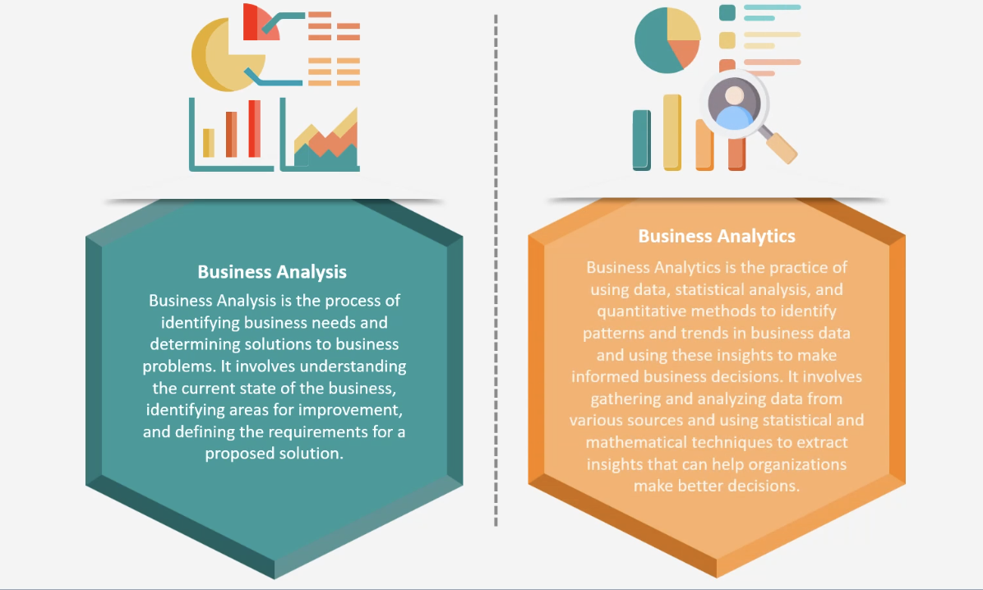

Slide 19
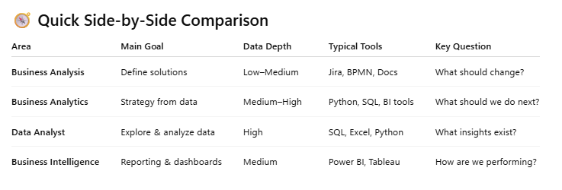

Slide 20
WHY BUSINESS ANALYSIS FOR CS STUDENTS?
“You don’t need to become a businessman — but you must understand business.”
Developers who understand business:
Write better software
Design better systems
Grow faster in careers
Analysis/Analytics sits at the intersection of:
Data
Software
Decision-making

Slide 21
INDUSTRY ROLES & CAREER PATHS
Business Analysts exist in almost every industry:
Software companies
Banks
Telecom
Healthcare
E-commerce
Career progression:
Junior BA → BA → Senior BA → Product Owner / PM / Strategy Analyst / BA Lead

Slide 22
PRACTICAL EXAMPLE
Real Example – Daraz
Daraz notices delayed deliveries.
BA: Maps supply chain
Finds bottlenecks
Identifies root causes
Suggests improvement steps
BA doesn’t drive trucks.
BA improves the process.”

Slide 23
BUSINESS PROBLEMS
Business Problems
Losing customers
Low sales / revenue
Slow operations
Poor customer experience
High cost of operations
For example: If customers are leaving, sales are decreasing, or complaints are increasing — these are business problems.
Business problems usually impact:
Money
Customers
Reputation
Growth
A Business Analyst first tries to understand these problems before thinking about technology.

Slide 24
TECHNICAL PROBLEMS
Technical Problems
Server down
Bugs in system
Database crash
Integration failure
Application not responding
For example:
Website not loading
App crashing
Data not saving
These problems are mostly handled by developers, testers, and IT teams.
Business Analysts do not fix technical problems themselves, but they must understand them.

Slide 25
Business vs Technical Problems
Business vs Technical Problems
Business Problem → WHAT is wrong & WHY
Technical Problem → HOW to fix it
BA focuses mainly on WHAT and WHY
Example:
Business Problem: Customers cannot place orders. Technical Problem: Payment gateway API is failing.
Business Analysts focus more on understanding WHAT and WHY, and then work with technical teams who decide HOW.

Slide 26
WEEK 2 – SNEAK PEAK
Understand organizational structures and departments
Learn common business models (B2B, B2C, SaaS)
Grasp key business terms used by analysts
Relate BA roles to real-world business functions

